Slide 1

CHAPTER 5
SEQUENCES,
MATHEMATICAL
INDUCTION, AND
RECURSION
Copyright © Cengage Learning. All rights reserved.

Slide 2
SECTION 5.6
Defining Sequences Recursively
Copyright © Cengage Learning. All rights reserved.

Slide 3
Defining Sequences Recursively
A sequence can be defined in a variety of different ways.
One informal way is to write the first few terms with the expectation that the general pattern will be obvious.
We might say, for instance, “consider the sequence 3, 5, 7, . . ..” Unfortunately, misunderstandings can occur when this approach is used.
The next term of the sequence could be 9 if we mean a sequence of odd integers, or it could be 11 if we mean the sequence of odd prime numbers.

Slide 4
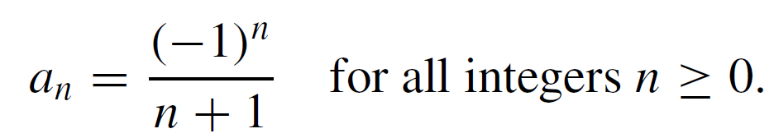
Defining Sequences Recursively
The second way to define a sequence is to give an explicit formula for its nth term.
For example, a sequence a₀, a₁, a₂ . . . can be specified by writing
The advantage of defining a sequence by such an explicit formula is that each term of the sequence is uniquely determined and can be computed in a fixed, finite number of steps, by substitution.

Slide 5
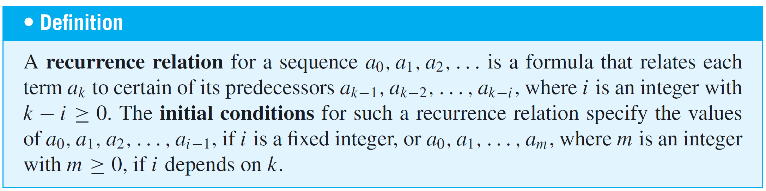
Defining Sequences Recursively
The third way to define a sequence is to use recursion.
This requires giving both an equation, called a recurrence relation, that defines each later term in the sequence by reference to earlier terms and also one or more initial values for the sequence.

Slide 6
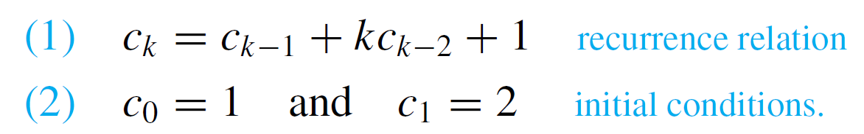
Example 1 – Computing Terms of a Recursively Defined Sequence
Define a sequence c₀, c₁, c₂, . . . recursively as follows: For all integers k ≥ 2,
Find c₂, c₃, and c₄.
Solution:

Slide 7
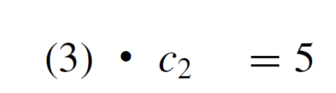


Example 1 – Solution
cont’d

Slide 8
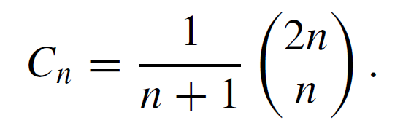
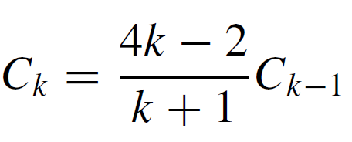
Example 4 – Showing That a Sequence Given by an Explicit Formula
Satisfies a Certain Recurrence Relation
The sequence of Catalan numbers, named after the Belgian mathematician Eugène Catalan (1814–1894), arises in a remarkable variety of different contexts in discrete mathematics. It can be defined as follows: For each integer n ≥ 1,
a. Find C₁,C₂, and C₃.
b. Show that this sequence satisfies the recurrence
relation for all integers k ≥ 2

Slide 9
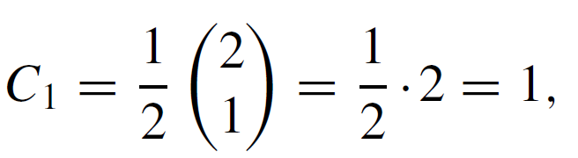
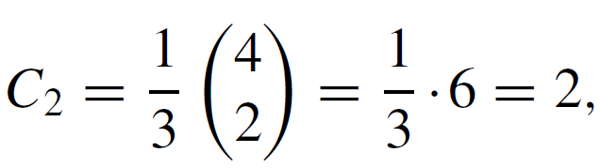
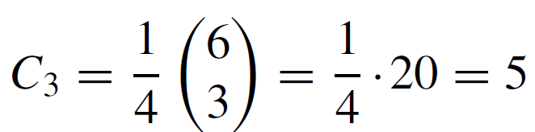
Example 4 – Solution
a.

Slide 10
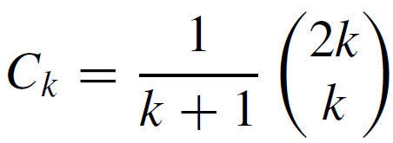

Example 4 – Solution
cont’d
b. To obtain the kth and (k – 1)st terms of the sequence,
just substitute k and k –1 in place of n in the explicit
formula for C₁, C₂, C₃, . . . .

Slide 11

Example 4 – Solution
cont’d
Then start with the right-hand side of the recurrence relation and transform it into the left-hand side: For each integer k ≥ 2,

Slide 12
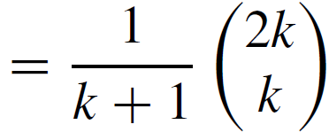



Example 4 – Solution
cont’d

Slide 13
Examples of Recursively Defined Sequences

Slide 14
Examples of Recursively Defined Sequences
Recursion is one of the central ideas of computer science.
To solve a problem recursively means to find a way to break it down into smaller subproblems each having the same form as the original problem—and to do this in such a way that when the process is repeated many times, the last of the subproblems are small and easy to solve and the solutions of the subproblems can be woven together to form a solution to the original problem.

Slide 15
Example 5 – The Tower of Hanoi
In 1883 a French mathematician, Édouard Lucas, invented a puzzle that he called The Tower of Hanoi (La Tour D’Hanoï).
The puzzle consisted of eight disks of wood with holes in their centers, which were piled in order of decreasing size on one pole in a row of three. Those who played the game were supposed to move all the disks one by one from one pole to another, never placing a larger disk on top of a smaller one.

Slide 16
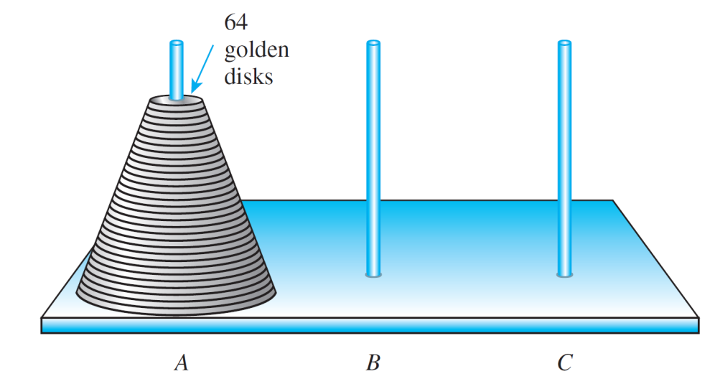
Example 5 – The Tower of Hanoi
cont’d
The puzzle offered a prize of ten thousand francs (about $34,000 US today) to anyone who could move a tower of 64 disks by hand while following the rules of the game. (See Figure 5.6.2) Assuming that you transferred the disks as efficiently as possible, how many moves would be required to win the prize?
Figure 5.6.2

Slide 17
Example 5 – Solution
An elegant and efficient way to solve this problem is to think recursively.
Suppose that you, somehow or other, have found the most efficient way possible to transfer a tower of k – 1 disks one by one from one pole to another, obeying the restriction that you never place a larger disk on top of a smaller one.
What is the most efficient way to transfer a tower of k disks from one pole to another?

Slide 18
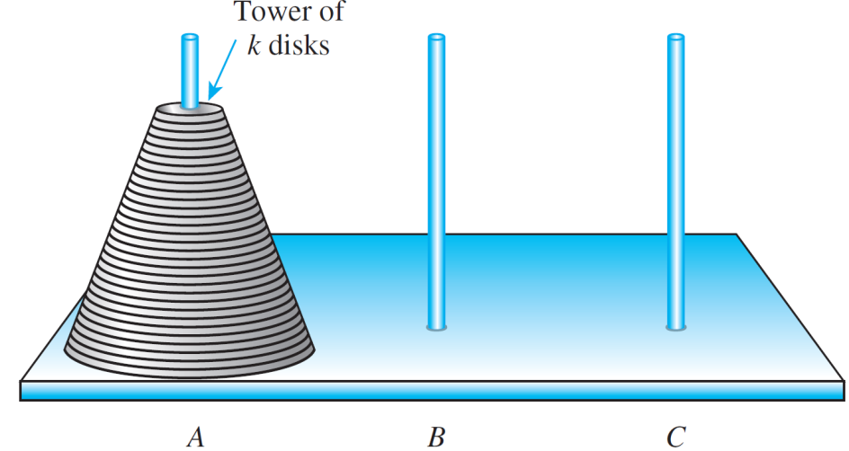
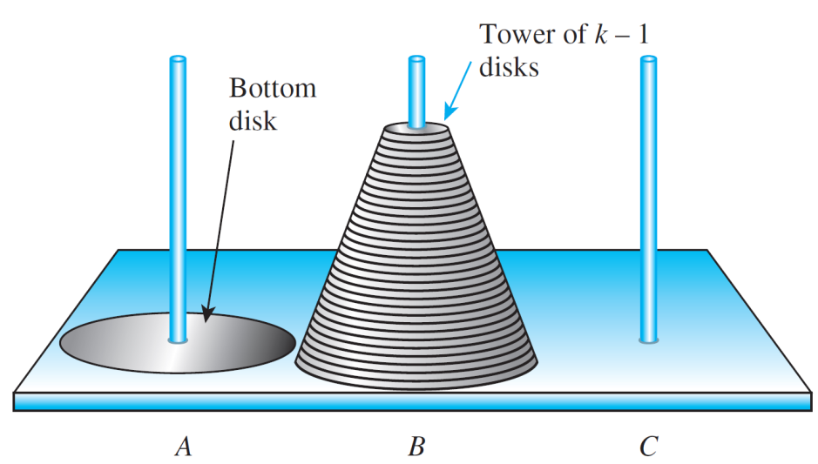
Example 5 – Solution
cont’d
The answer is sketched in Figure 5.6.3, where pole A is the initial pole and pole C is the target pole, and is described as follows:
Initial Position
(a)
Position after Transferring k – 1 Disks from A to B
(b)
Moves for the Tower of Hanoi
Figure 5.6.3

Slide 19
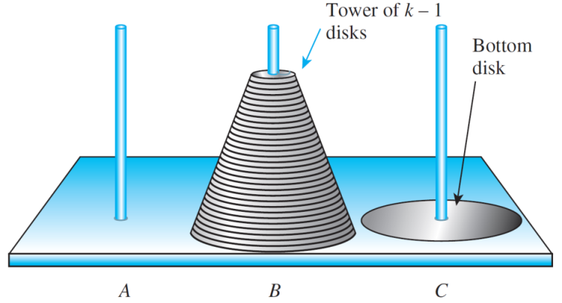
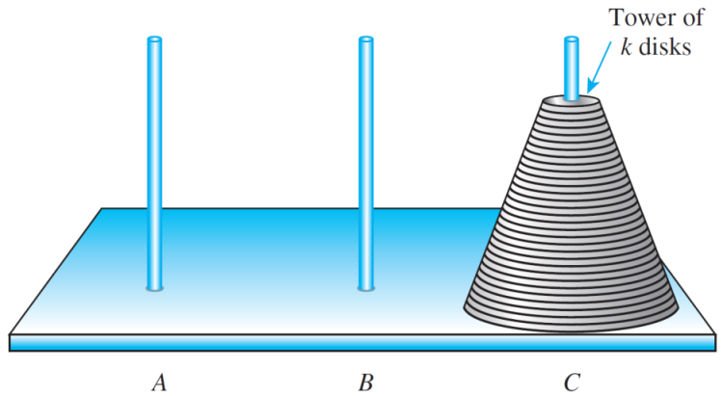
Example 5 – Solution
cont’d
Step 1: Transfer the top k – 1 disks from pole A to pole B.
If k > 2, execution of this step will require a
number of moves of individual disks among the
three poles. But the point of thinking recursively is
not to get caught up in imagining the details of how
those moves will occur.
Position after Moving the Bottom Disk from A to C
(c)
Position after Transferring k – 1 Disks from B to C
(d)
Moves for the Tower of Hanoi
Figure 5.6.3

Slide 20
Example 5 – Solution
cont’d
Step 2: Move the bottom disk from pole A to pole C.
Step 3: Transfer the top k – 1 disks from pole B to pole C.
(Again, if k > 2, execution of this step will require
more than one move.)
To see that this sequence of moves is most efficient,
observe that to move the bottom disk of a stack of k disks
from one pole to another, you must first transfer the top
k – 1 disks to a third pole to get them out of the way.

Slide 21
Example 5 – Solution
cont’d
Thus transferring the stack of k disks from pole A to pole C requires at least two transfers of the top k – 1 disks:
one to transfer them off the bottom disk to free the bottom disk so that it can be moved and another to transfer them back on top of the bottom disk after the bottom disk has
been moved to pole C.

Slide 22
Example 5 – Solution
cont’d
If the bottom disk were not moved directly from pole A to pole C but were moved to pole B first, at least two additional transfers of the top k – 1 disks would be necessary:
one to move them from pole A to pole C so that the bottom disk could be moved from pole A to pole B and another to move them off pole C so that the bottom disk could be moved onto pole C.
This would increase the total number of moves and result in a less efficient transfer.

Slide 23
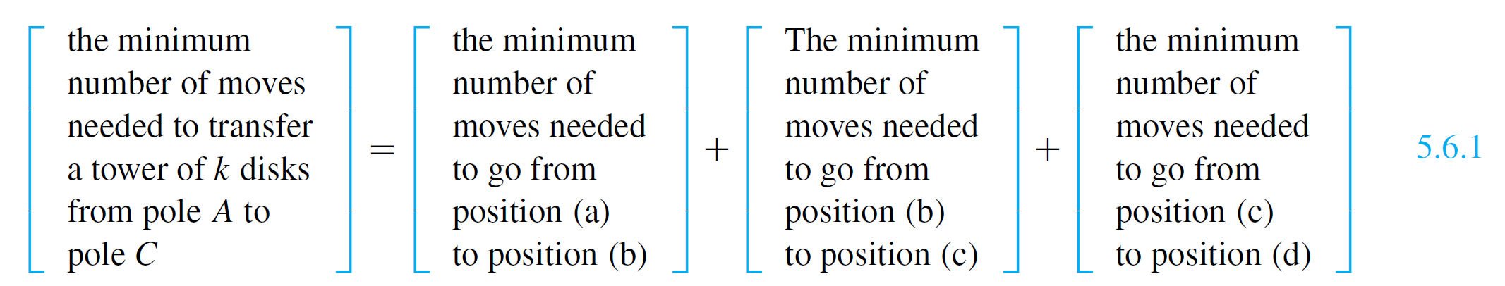
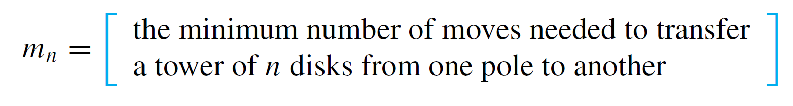
Example 5 – Solution
cont’d
Thus the minimum sequence of moves must include going from the initial position (a) to position (b) to position (c) to position (d).
It follows that
For each integer n ≥ 1, let

Slide 24
Example 5 – Solution
cont’d
Note that the numbers m_{n} are independent of the labeling of the poles; it takes the same minimum number of moves to transfer n disks from pole A to pole C as to transfer
n disks from pole A to pole B, for example.
Also the values of m_{n} are independent of the number of larger disks that may lie below the top n, provided these remain stationary while the top n are moved.
Because the disks on the bottom are all larger than the ones on the top, the top disks can be moved from pole to pole as though the bottom disks were not present.

Slide 25

Example 5 – Solution
cont’d
Going from position (a) to position (b) requires m_{k – 1} moves, going from position (b) to position (c) requires just one move, and going from position (c) to position (d) requires m_{k – 1} moves.
By substitution into equation (5.6.1), therefore,
The initial condition, or base, of this recursion is found by using the definition of the sequence.

Slide 26
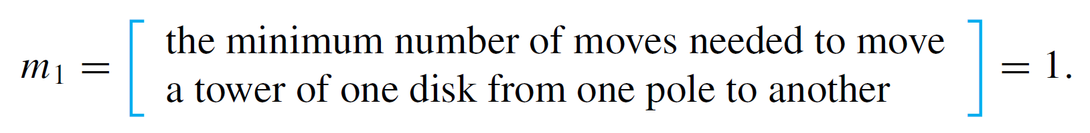
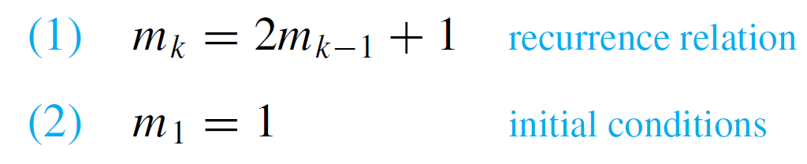
Example 5 – Solution
cont’d
Because just one move is needed to move one disk from one pole to another,
Hence the complete recursive specification of the sequence m₁, m₂, m₃, . . . is as follows:
For all integers k ≥ 2,

Slide 27
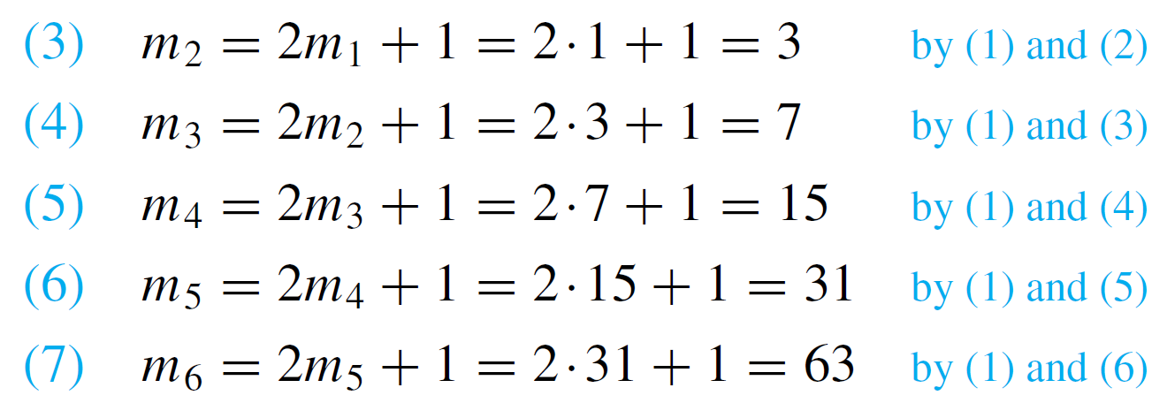
Example 5 – Solution
cont’d
Here is a computation of the next five terms of the sequence:
Going back to the legend, suppose the priests work rapidly and move one disk every second.
Then the time from the beginning of creation to the end of the world would be m₆₄ seconds.

Slide 28

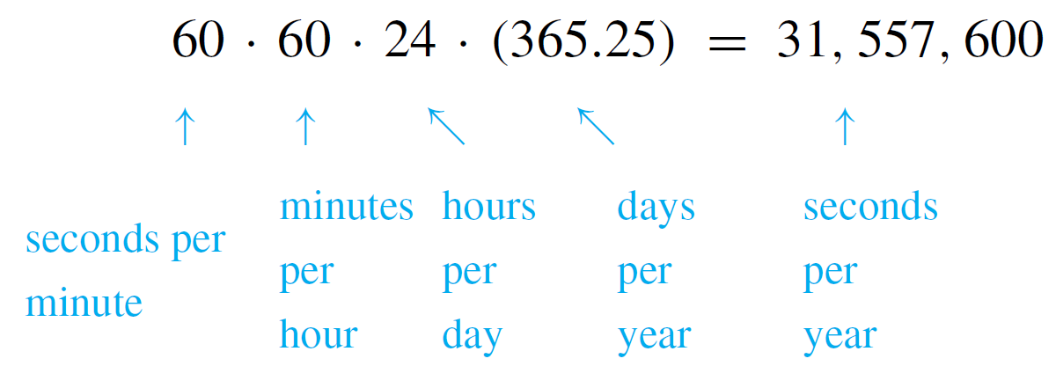
Example 5 – Solution
cont’d
We can compute m₆₄ on a calculator.
The approximate result is
which is obtained by the estimate of
seconds in a year (figuring 365.25 days in a year to take leap years into account). Surprisingly, this figure is close to some scientific estimates of the life of the universe!

Slide 29
Recursive Definitions of Sum and Product

Slide 30
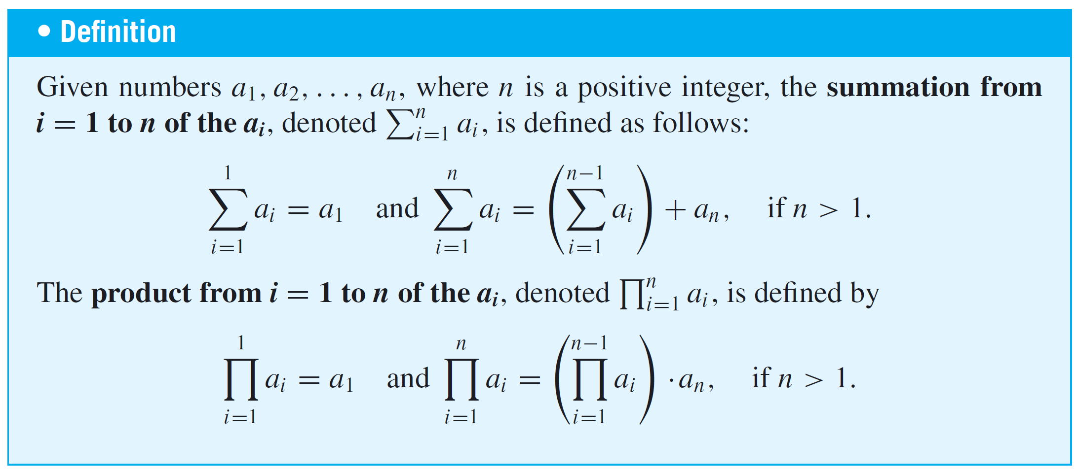
Recursive Definitions of Sum and Product
Addition and multiplication are called binary operations because only two numbers can be added or multiplied at a
time. Careful definitions of sums and products of more than
two numbers use recursion.

Slide 31
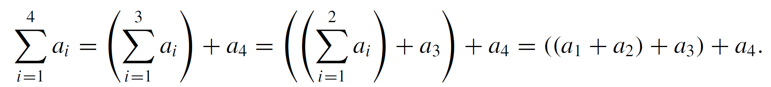
Recursive Definitions of Sum and Product
The effect of these definitions is to specify an order in which sums and products of more than two numbers are computed. For example,
The recursive definitions are used with mathematical induction to establish various properties of general finite sums and products.

Slide 32
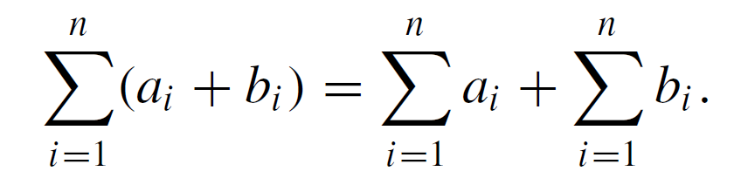
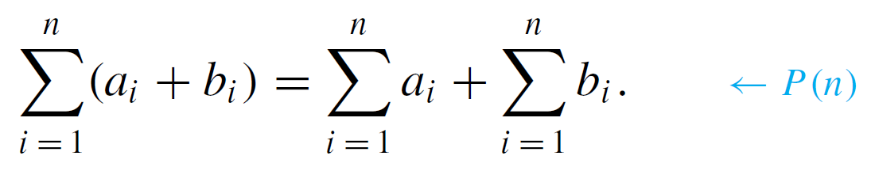
Example 9 – A Sum of Sums
Prove that for any positive integer n, if a₁, a₂, . . . , a_{n} and b₁, b₂, . . . , b_{n} are real numbers, then
Solution:
The proof is by mathematical induction. Let the property P(n) be the equation

Slide 33
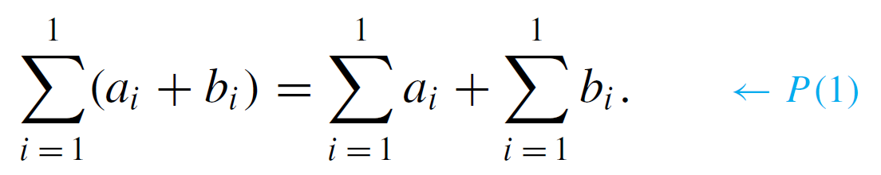
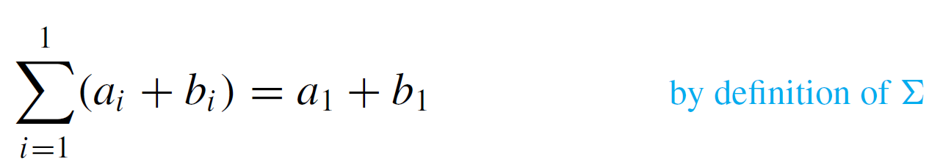
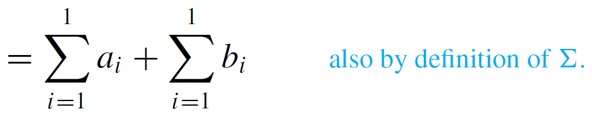
Example 9 – Solution
cont’d
We must show that P(n) is true for all integers n ≥ 0.We do this by mathematical induction on n.
Show that P(1) is true: To establish P(1), we must show
that
But
Hence P(1) is true.

Slide 34
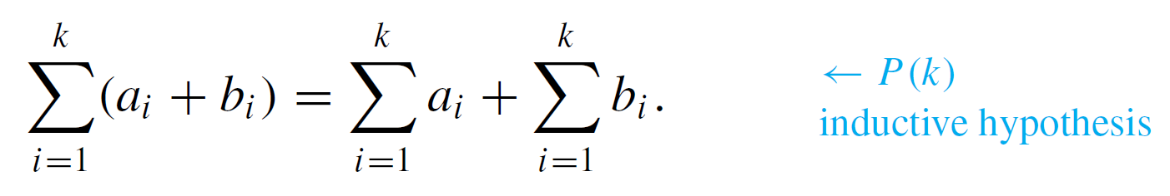
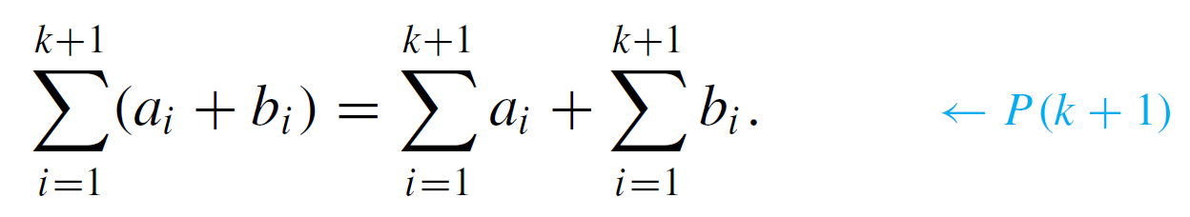
Example 9 – Solution
cont’d
Show that for all integers k ≥ 1, if P(k) is true then
P(k + 1) is also true: Suppose a₁, a₂, . . . , a_{k}, a_{k + 1} and b₁, b₂, . . . , b_{k}, b_{k + 1} are real numbers and that for some k ≥ 1
We must show that
[We will show that the left-hand side of this equation equals the right-hand side.]

Slide 35
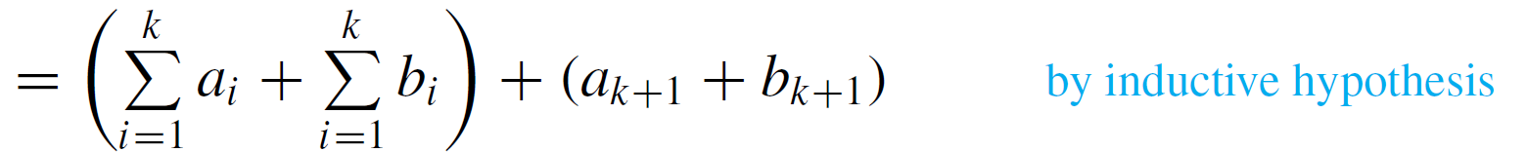
Example 9 – Solution
cont’d
But the left-hand side of the equation is

Slide 36
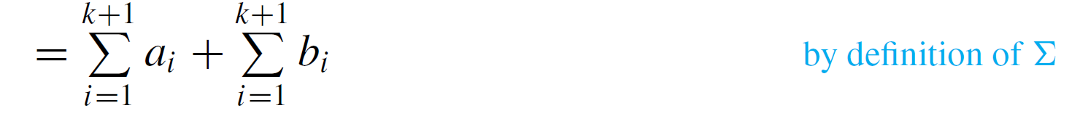
Example 9 – Solution
cont’d
which equals the right-hand side of the equation. [This is what was to be shown.]

